Slide 1
Computer Security IT423
Semester II
2017 - 2018
Dr. Saman Mirza Abdullah
saman.mirza@ishik.edu.iq

Slide 2
Data Encryption Standard (DES)

Slide 3
Class Objective
The main objective of this class is to:
To review a short history of DES
To define the basic structure of DES
To describe the details of building elements of DES
To describe the round keys generation process

Slide 4
Confusion and Diffusion
confusion
Make relation between statistics of ciphertext and the value of the encryption key as complex as possible.
diffusion
Diffuse statistical property of plaintext digit across a range of ciphertext digits
Each plaintext digits affects value of many ciphertext digits, or has same relation with many ciphertext digits.

Slide 5
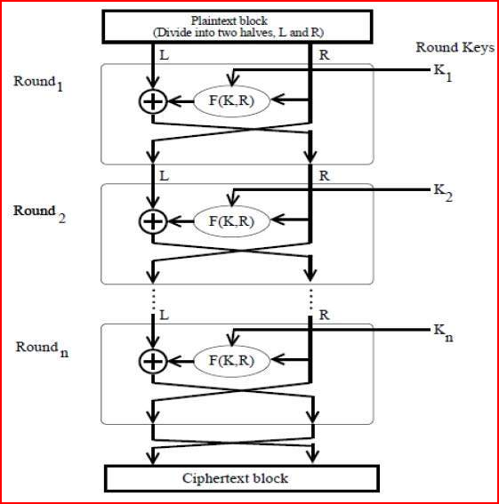
Feistel Cipher
It is a design model, not specific method.
Uses same algorithm for encryption and decryption.
Has multiple round of processing plaintext.
Each round consists S-box and P-box step.

Slide 6
DES
The Data Encryption Standard (DES) is
a symmetric-key block cipher published in 1973 by the National Institute of Standards and Technology (NIST), as a proposal.
It has been accepted by as a draft of the Federal Information Processing Standard (FIPS), in March 1975 .
Although the draft was criticized, on 1977 the drafted has been published.
Notes:
Ask them what is the difference between symmetric and asymmetric key block
Symmetric is one secret key using between sender and receiver.
Asymmetric is using public key at sender side and private key at receiver side. So, it utilizes two keys.

Slide 7
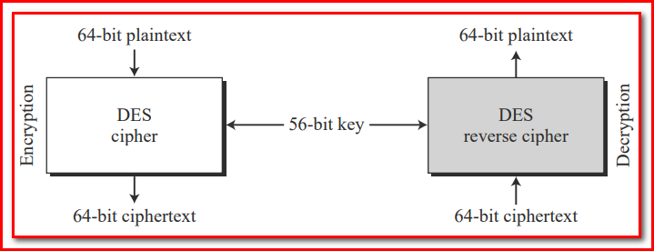
Overview
DES takes:
A 64-bit plaintext and creates a 64-bit ciphertext; at the decryption site,
A 64-bit ciphertext and creates a 64-bit block of plaintext.
The same 56-bit cipher key is used for both encryption and decryption.

Slide 8
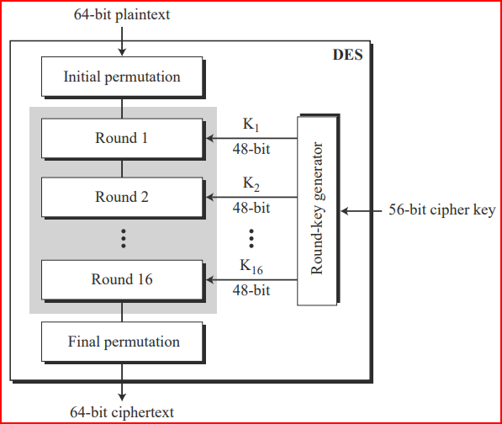
DES Structure Encryption
Has two P-boxes:
Initial and final permutation.
Each is inverse to the other.
Has 16 rounding or (S-box).
Accepts 64 bit Plaintext.
Has 56 bit cipher key, 48 bit used.
Based on some predefined algorithms.

Slide 9
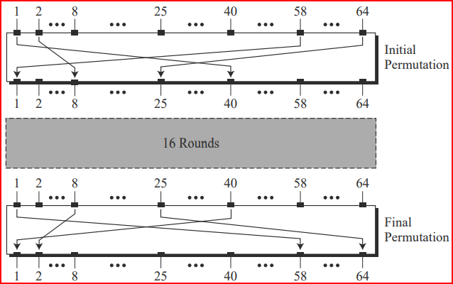
DES Structure Encryption / (P-box )
Has two P-boxes:
Initial and final permutation.
Each is inverse to the other.
It is applied directly on 64 bit of the plaintext.
They are keyless.
Increases the role of hardware in encryption process.

Slide 10
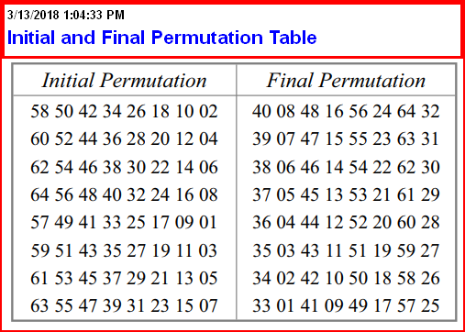
DES Structure Encryption / (P-box )
Find the output of the initial permutation box when the input is given in hexadecimal
0x0002 000 0000 0001
We have only the 15th bit and 64th bit are one.
15 → 63
64→25

Slide 11
DES Structure Encryption / (P-box )
Find the output of the Final permutation box when the input is given in hexadecimal
0x 0000 0080 0000 0002
We have only the 25th bit and 63rd bit are one.
63 → 15
25→64

Slide 12
DES Structure Encryption
Done
What are going on inside the rounds?
Done

Slide 13
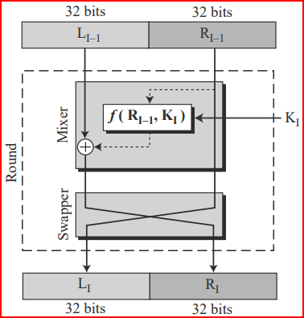
DES Structure Encryption / Rounds
The input to the rounds will be divided into two parts (Left and Right).
The round has Swapper and Mixer processes.
Swapper inverted the right half of the input with left.
Mixer uses a Function to mix the first half with a key.
$f(R_{i−1},K_{i})$

Slide 14
DES Structure …/ Rounds/ $f(R_{i−1},K_{i})$
This Called the DSE function.
It is the hart of the DES structure.
It is apply a 48 bit key to the 32 bit input. Always the rightmost bit.
It gives at output 32 bit.
It comes in different steps.

Slide 15
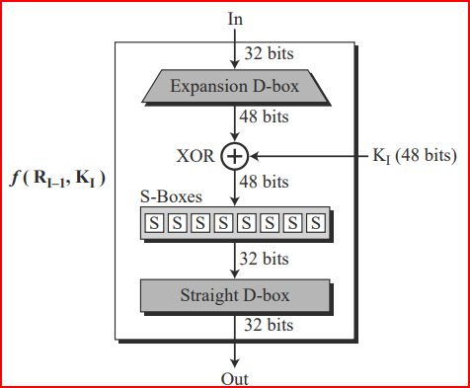
DES Structure …/ …/ $f(R_{i−1},K_{i})/steps$
These steps are occurred in the DES Function
Expansion D-box.
Whitener XOR
S-Box
Straight D-box

Slide 16
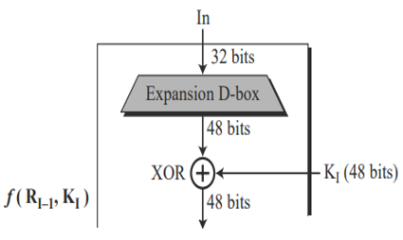
$$f(R_{i−1},K_{i})/Expansion$$
Why Expansion is needed?
Input to the round steps has 32 bits size, the Key has 48 bits. So, expansion needed.

Slide 17
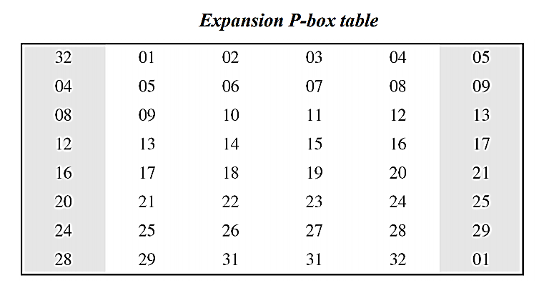
$$f(R_{i−1},K_{i})/Expansion$$
Input will be divided into 8 four bit sections.
Each 4 bit section expends to 6 bits section.

Slide 18
$f(R_{i−1},K_{i})/$Whitener XOR

Slide 19
$$f\left(R_{i−1},K_{i}\right) /S−boxes$$
S-boxes are doing real mixing. (Confusion).
DSE has 8 S-boxes, each.
Has 6 inputs and 4 outputs.
How the process is going on inside each S-boxes.

Slide 20
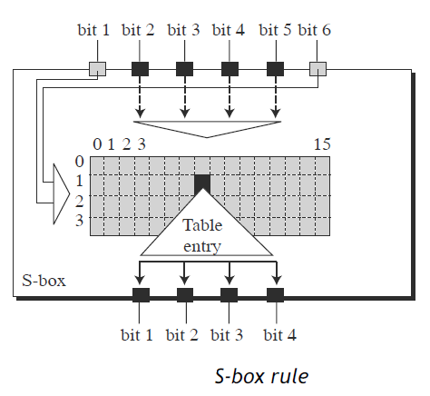
$$f\left(R_{i−1},K_{i}\right) /S−boxes$$
For each S-box, we have a truth table.
The truth table for S-box 1 is differ from others.
There is no similar truth table among the eight boxes.

Slide 21
$$f\left(R_{i−1},K_{i}\right) /S−boxes$$
Use the S-box below to get the output of the 110001
The 1st bit is (1) and the 6th bit is (1), so the row is 11 which means (3)
The rest of the bits are (1000) which means (8).
The box with index (3,8) has a value of (05).
Converting (05) to binary, it will be (0101).

Slide 22
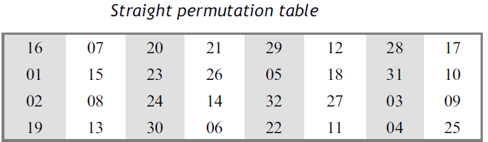
$$f\left(R_{i−1},K_{i}\right) \\ Straight Permutation$$
It is the final stage of DES function. Sometimes called as Final Permutation.
It is the 32 bits input / 32 bites output permutation operation.
It follows a straight permutation truth table, as shown below:
According to the above table, the 7th bit of the input will be the 2nd bit of the output.

Slide 23
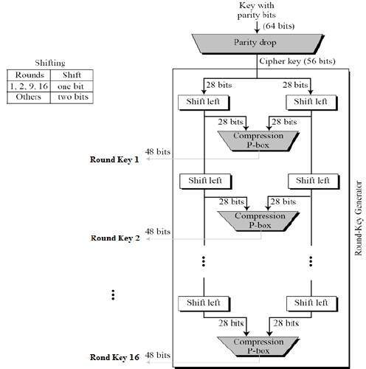
Key Generation
First step is Parity drop:
Removing the parity bit. (if Available).
Do permutation according to a give table.
Output is 64 bits input becomes 56 bits.
Divide the 56 bits into two parts, each 28 bits.
Left part and right part.
Do left bit shifting.
Given permutation / compression table, do permutation to reduce the size to 48 bits.

Slide 24
Key Generation Example
A 10 bits key is shared between sender and receiver. Use the following information to generate K₁ and K₂, which each has 8 bits sizes.
K=(10100 00010) is the main key.
No parity bits are there.
P₁₀ permutation is (3 5 2 7 4 10 1 9 8 6)
P₈ permutation is (6 3 7 4 8 5 10 9).
==========================================
No parity bits will be removed.
P₁₀ (K) = P10 (10100 00010) = (10000 01100).
Left part is (10000) and Right part is (01100).
Applying left shifting on both part L = 00001 and R = 11000.
Combining the L and R = 0000111000
P8( L and R) = P₈ (00001 11000) = (10100100)
Therefore, the sub-key k₁ is (10100100)

Slide 25
Key Generation Example
No parity bits will be removed.
P₁₀ (K) = P10 (10100 00010) = (10000 01100).
Left part is (10000) and Right part is (01100).
Applying left shifting on both part L = 00001 and R = 11000.
Combining the L and R = 0000111000
P₈( L and R) = P₈ (00001 11000) = (10100100)
Therefore, the sub-key k₁ is (10100100)
With which of the above information we should start for computing the set values of sub-key k₂?

Slide 26
Key Generation Example
No parity bits will be removed.
P₁₀ (K) = P10 (10100 00010) = (10000 01100).
Left part is (10000) and Right part is (01100).
Applying left shifting on both part L = 00001 and R = 11000.
Do left shifting bit.
L=00010 and R= 10001
Combining the L and R = 00010 10001
P₈ permutation is (6 3 7 4 8 5 10 9).
P₈( L and R) = P₈ (00010 10001) = (10010010)
Therefore, the sub-key k₁ is (10010010)

Slide 27
Quiz ?
When need to find the sub-key K3,
Which information will be taken in consideration?
Dose the process of round 3 will go as round or not? If any change is there show and highlight the change.

Slide 28
Read More
The DES Algorithm Illustrated.pdf in the same folder.

Slide 29
Class End

