Slide 1
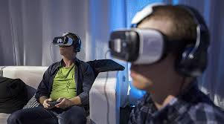
Ishik University
Faculty of Science
Dep. of Information Technology
By: Raz Dara Mohammad Amin

Slide 2
OUT LINE
Keyboard
Mac Keyboard
Mouse
Five basic actions of the mouse.

Slide 3
Objective
Learning what is keyboard and the different types of keys.
Getting general knowledge about Mac Keyboard.
Learning what is Mouse and getting general knowledge about it.
Learn the Five basic actions of the mouse.

Slide 4
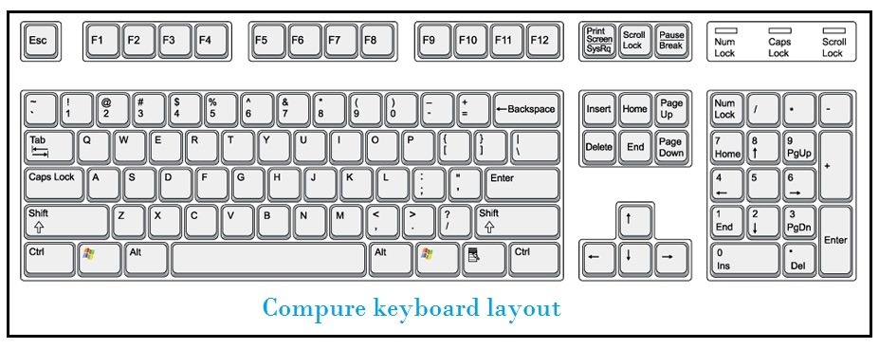
Keyboard
The keyboard is the most common way to enter information into a computer.
Today, standard keyboards have 104 or 105 keys. An electronic circuit inside the keyboard transmits the code of a pressed key to the CPU.

Slide 5
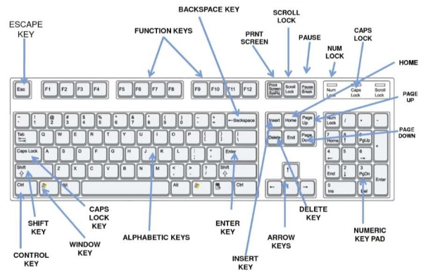
Keyboard
Parts of Keyboard

Slide 6
Keyboard
Most of the keys on a keyboard are used to enter numbers, letters, and punctuation marks.
There are also function keys (used for special functions in applications), keys for working with text and documents (for example, the Page Up and Page Down keys), and other keys used to make special key combinations (Alt and Ctrl).
There are some different arrangements of alphabetic, numeric, and punctuation symbols on keys.
These different keyboard layouts exist due to different languages.

Slide 7
Keyboard
QWERTY is the most used modern-day keyboard layout on English-language computers.
It takes its name from the first six letters at the upper left of the keyboard.
Many modern keyboards have extra keys for accessing music, web, and other frequently used programs and features, such as a mute button, volume buttons, or a sleep button.

Slide 12
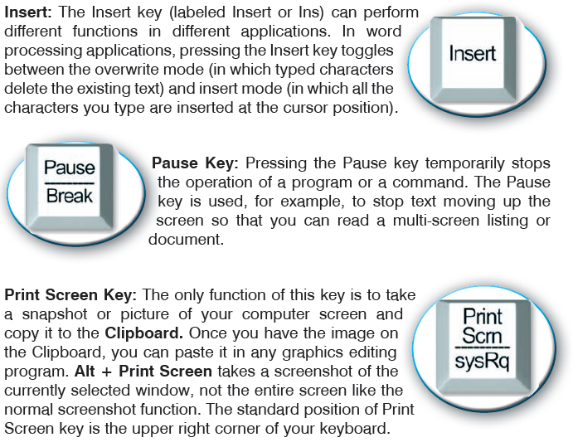

Slide 13
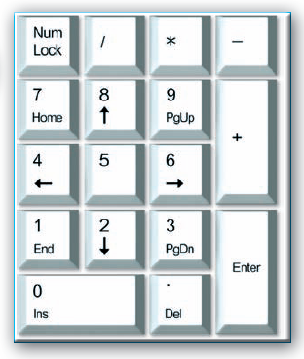

Slide 14
Mac Keyboard
Mac keyboard has few unique sections: Function keys (in light blue), which provides access to various functions in Mac itself or Mac OS system.
By combining them with the FN key, you'll get access to F1 - F12 keys, which can be associated with particular application features (useful in Photoshop for example).

Slide 15
The second section is the modifier keys (in light yellow). Shift allows to type uppercase letters and other additional characters.
Command and Alt/Option are used in keyboard shortcuts, as well as the Control key, which is used almost exclusively by Mac OS X and Apple programs.
Return and left Shift has two alternatives, one used in the US and Eastern Asia (horizontal Return and long Shift), and second, used in Europe, Middle East and Africa (vertical Return and short left Shift).
On the diagram, this is shown by dashed lines. Of course, MacBook keyboards have lots of localizations, the most common - US English - is shown above.

Slide 16
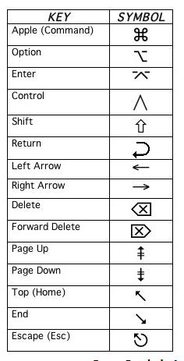
MacBook Air 11" has slightly different keyboard, with smaller top and bottom row keys to accommodate smaller laptop size.
Newest MacBooks Pro with TouchBar don't have upper F keys row, instead, they have a touchscreen which changes displayed options based on context.

Slide 17
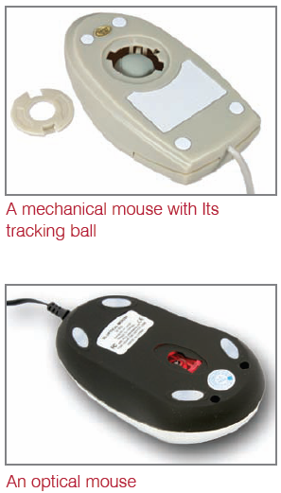
Mouse
A mouse is the most common input device along with the keyboard. It is used to point to things and select things on the screen. It functions by detecting two-dimensional motion relative to its supporting surface.
You use your mouse whenever you want to move your cursor or activate something. Your mouse senses your motion and your clicks and sends them to the computer so it can respond appropriately. The mouse’s motion typically translates into the motion of a pointer on a display, which allows for fine control of a GUI (Graphical User Interface).

Slide 18
Five basic actions of the mouse
Click: Press and release the left mouse button.
Right-Click: Press and release the right mouse button.
Double-Click: Press and release the left mouse button twice rapidly.
Drag and Drop: Press and do not release the left mouse button, then move the mouse with the button still held down, and finally release the button.
Scroll: Many mice have a scroll wheel between the left and right buttons.

Slide 19
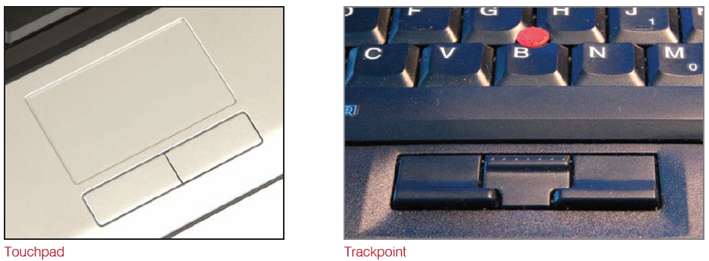
Touchpad and TrackPoint are two alternative pointing devices for mice that are usually found on laptop computers

Slide 20
THANK YOU

