Slide 1
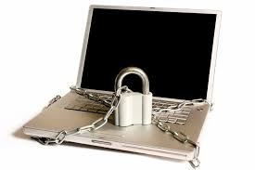
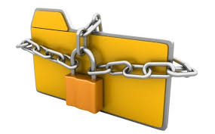
Computer Security
Faculty of Science
IT Department
By Raz Dara MA.

Slide 2
What is computer security?
Computer Security is the process of preventing and detecting unauthorized use of your computer.
It involves the process of safe guarding against intruders from using your computer resources for malicious intents.
Intruder :An attacker that gains, or tries to gain, unauthorized access to a system
malicious: intended to harm or upset other ... to a computer system, or to steal private information from a computer system

Slide 3
Computer Security is concerned with four main areas:
Confidentiality:- Only authorized users can access the data resources and information.
Integrity:- Only authorized users should be able to modify the data when needed.
Availability:- Data should be available to users when needed.
Authentication:- are you really communicating with whom you think you are communicating with.

Slide 4
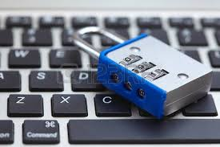
Why is computer security so important?
Prevention of data theft such as bank account numbers, credit card information, passwords, work related documents or sheets, etc.
is essential in today’s communications since many of our day to day action
Data present in a computer can also be misused by unauthorized intrusions' depend on the security of the data paths.
An intruder can modify and change the program source codes and can also use your pictures or email accounts to create nasty content such as inappropriate images, fake misleading and offensive social accounts.

Slide 5
Why is computer security so important?
Malicious intents can also be a factor in computer security. Intruders often use your computers for attacking other computers or websites or networks for creating big destructions..
Vengeful hackers (Bad) might crash someone’s computer system to create data loss.
DDOS (distributed denial of service ) attacks can be made to prevent access to websites by crashing the server.
Above factors imply that your data should remain safe and confidential. Therefore, it is necessary to protect your computer and hence the need for Computer Security arises.

Slide 6
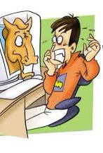
The most widely used attacks against a computer system
Trojans/trapdoors
Worms
viruses
social networking and eavesdropping(man-in-the-middle attack)
Also popular are DoS/DDoS attacks, which can be used to disrupt services.
Notes:
Deterrents =prevention
Intrusion = attack or disturbance

Slide 7
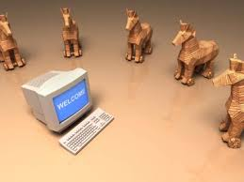
Trojan/trapdoors
A Trojan horse or Trojan is a type of malware that is often masked as legal software.
Trojans can be employed by cyber-thieves and hackers trying to gain access to users' systems.
Users are typically tricked by some form of social engineering into loading and executing Trojans on their systems.
Once activated, Trojans can enable cyber-criminals to spy on you, steal your sensitive data, and gain backdoor access to your system.
Malware : software which is specifically designed to disrupt, damage, or gain authorized access to a computer system.

Slide 8
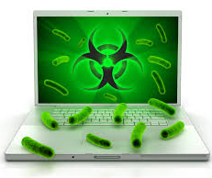
Computer WORM
A computer worm is a standalone malware computer program that replicates itself in order to spread to other computers.
Often, it uses a computer network to spread itself, relying on security failures on the target computer to access.

Slide 9
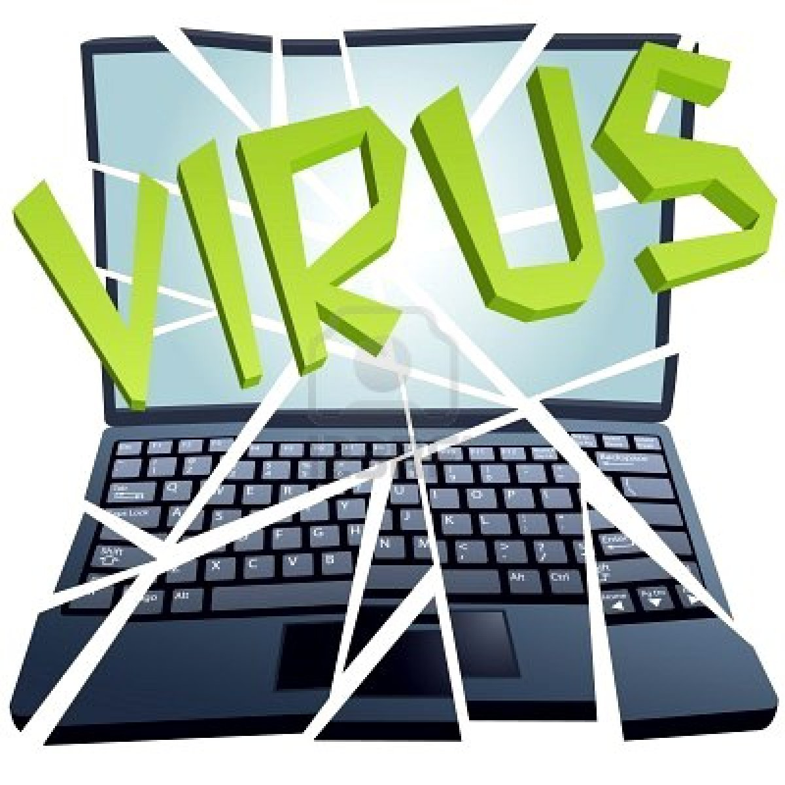
Computer Viruses
A computer virus is a small program written to alter the way a computer operates, without the permission or knowledge of the user. A virus must meet two criteria:
It must execute itself. It will often place its own code in the path of execution of another program.
It must replicate itself. For example, it may replace other executable files with a copy of the virus infected file. Viruses can infect desktop computers and network servers alike.

Slide 10
Man in the Middle Attack
Bob, Eve( Classmates!) want to communicate “securely”
Nancy(intruder) may intercept, delete, add messages
Eve
Bob
channel
data, control messages
secure
sender
secure
receiver
data
data
Nancy

Slide 11
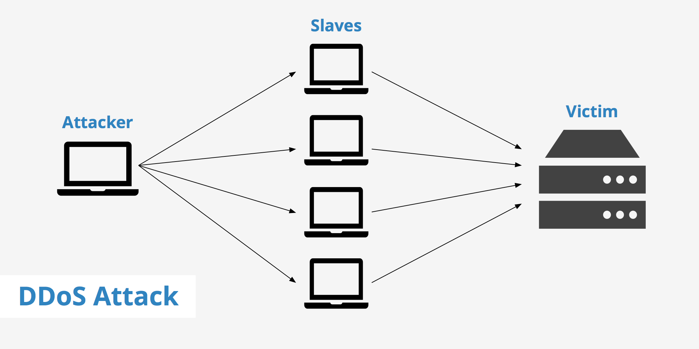
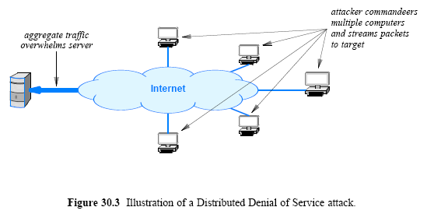
DDoS Attack
DDoS is short for Distributed Denial of Service.
DDoS is a type of DOS attack where multiple compromised systems, which are often infected with a Trojan , are used to target a single system causing a Denial of Service (DoS) attack.
Victims of a DDoS attack consist of both the end targeted system and all systems maliciously used and controlled by the hacker in the distributed attack.

Slide 12
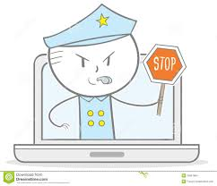
How to Prevent Attacks
Measures include installing legally purchased software, as they are generally free from such Trojans or viruses, using good anti-virus solutions with properly defined system rules.
Hardware and software firewalls help in blocking unauthorized users from accessing your computer.
Using a large complex password comprising of several special characters, numbers and alphabets in making it largely impossible for a hacker to crack your account easily.
Cryptography (especially encryption) plays an important role in keeping our sensitive information safe and secret.

Slide 13
Questions ???

