Slide 1
Ishik University
Faculty of Science
Dep. of Information Technology
By: Raz Dara Mohammad Amin

Slide 2
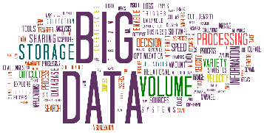
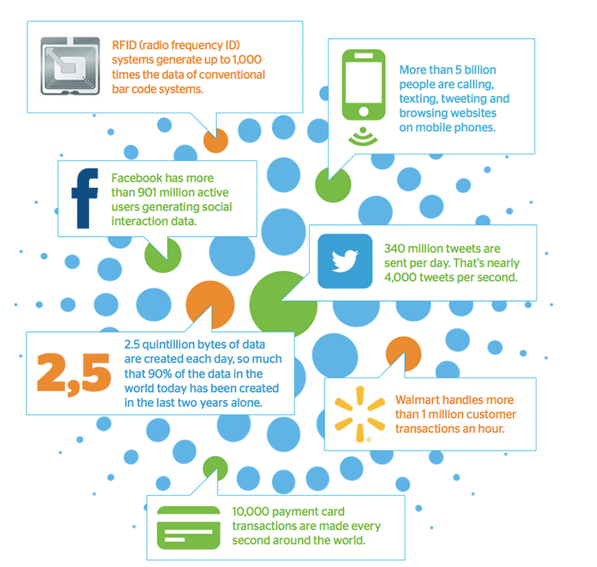
What is BIG DATA?
Insights from big data can enable all employees to make better decisions—deepening customer engagement, optimizing operations, preventing threats and fraud, and capitalizing on new sources of revenue.
Big data is being generated by everything around us at all times.

Slide 3
What is BIG DATA?
It is creating a culture in which business and IT leaders must join forces to realize value from all data.
Insights from big data can enable all employees to make better decisions—deepening customer engagement, optimizing operations, preventing threats and fraud, and capitalizing on new sources of revenue.
But escalating demand for insights requires a fundamentally new approach to architecture, tools and practices.

Slide 4
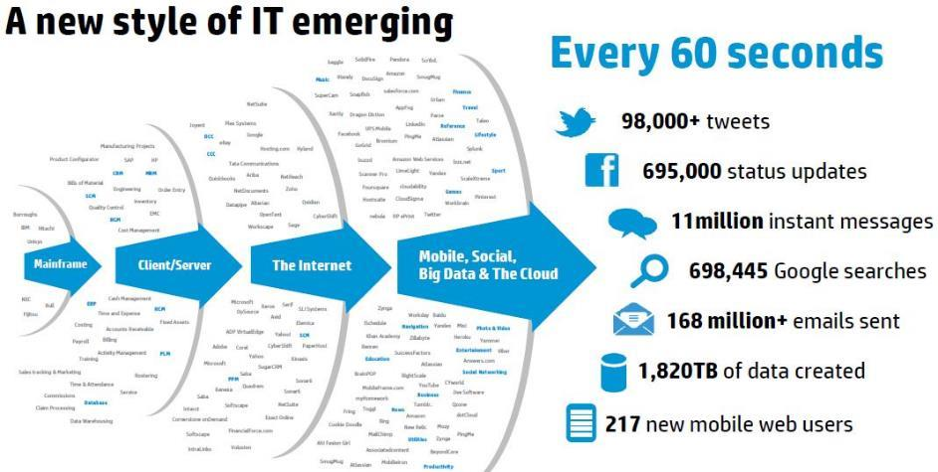
What is BIG DATA?
More than 300 Petabyte daily!
A petabyte (PB) is 10¹⁵ bytes of data (or 1,000 TB)

Slide 5
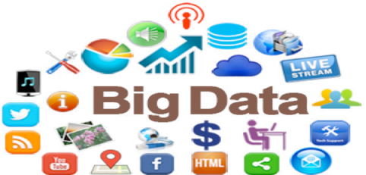
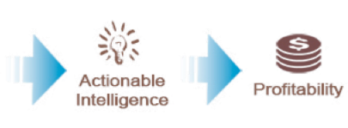
Why are we interested in BIG DATA?
Data is the new “OIL” resource, difficult to extract, it comes in many types, difficult to refine
However, it if obtained it has the potential to profoundly affect every aspect of our lives.

Slide 6
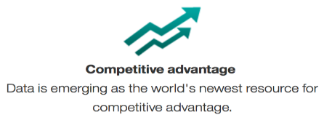
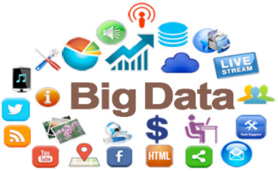
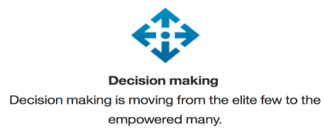
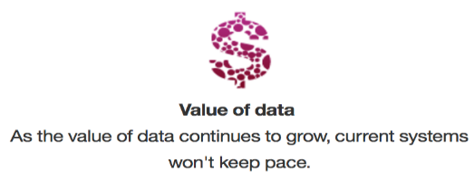
Why are we interested in BIG DATA?

Slide 7
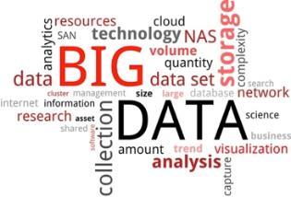
Why are we interested in BIG DATA?
Driving new insights from previously untouched data & integrate that insight into current processing.
The application of new tools to do more analytics on more data for more people.

Slide 8
Characteristics of BIG DATA
We need to understand the characteristics of BIG DATA first.

Slide 9
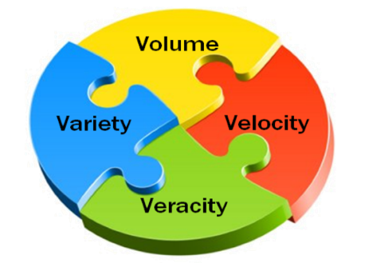
Characteristics of BIG DATA
Volume: data will be x50 in 2020 (compared to 2010)
The 4 V’s
Velocity: data is generated at much higher rates as more devices are becoming digital.
Variety: 80% of the data is unstructured having different forms.
Veracity: accuracy or conformity of facts is of great importance.

Slide 10
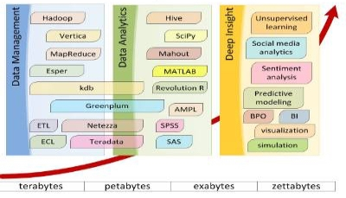
BIG DATA Analytics: The Picture
The major software components and their role

Slide 11
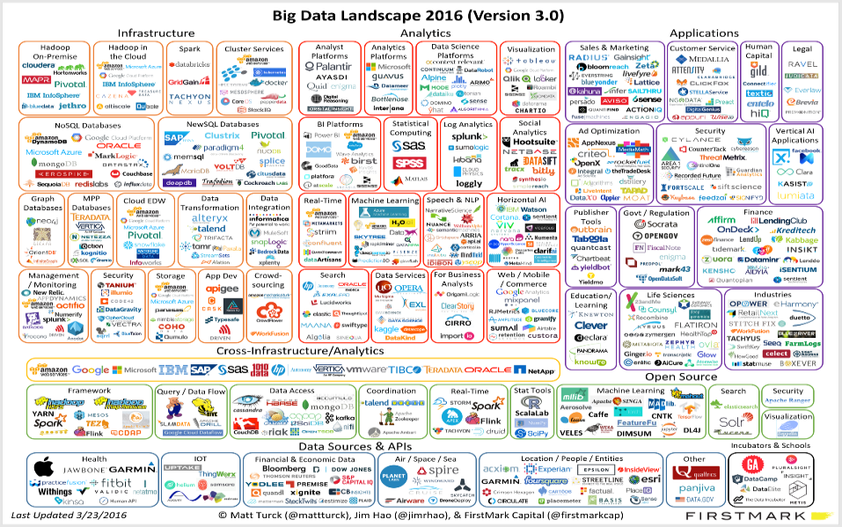

Slide 12
BIG DATA Echosystem: Basics
Growing storage problems.
Handling massive quantity of structured and unstructured data.
Cost of processing.
Fault tolerance.
Hadoop is an open source, Java-based programming framework that supports the processing and storage of extremely large data sets in a distributed computing environment.
It uses commodity hardware (PCs connected to network).
Supports distributed file storage via HDFS with replication.
Processing with fault tolerance.

Slide 13
Storage & Processing
!
Size limited by the size of local storage and processing power is bound by the CPU capabilities.
Cost, Feasibility, Advantage?

Slide 14
Storage & Processing
Shared distributed storage , distributed processing

Slide 15
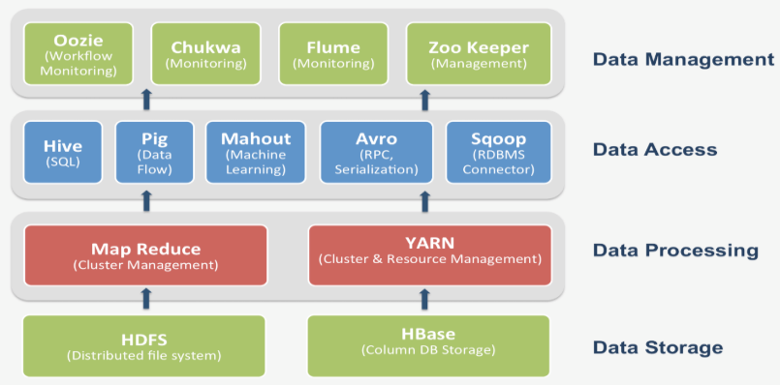
Hadoop, HDFS and others?

Slide 16
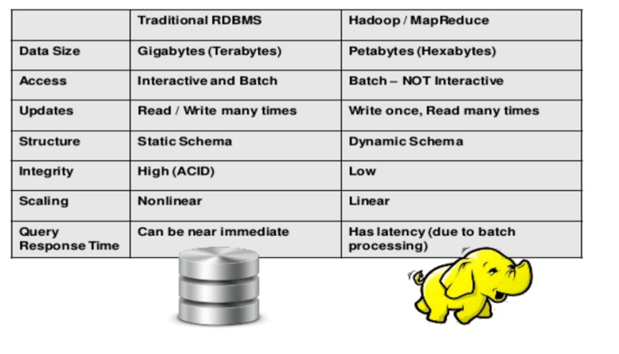
Hadoop, HDFS and others?
* ACID (Atomicity, Consistency, Isolation, Durability)

Slide 17
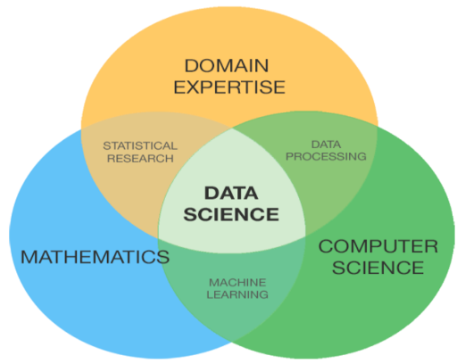
BIG DATA & Computer Science
Data Structures.
Programming Languages (Java, Python, Scala, R)
Artificial Intelligence (Data Mining, NLP, Machine Learning)
Networking.
Etc.

Slide 18
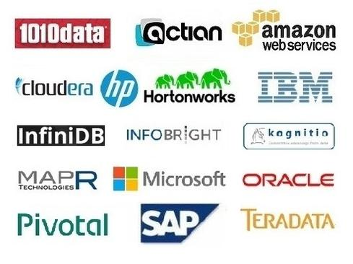
Who are the players?

Slide 19
Thank You

