Slide 1
Multimedia System
Assist. Lecturer
Safeen H. Rasool
Collage of Science
Department of IT

Slide 2
Course Outline
Introduction to multimedia technology
Historical review, Component of multimedia, Multimedia applications
Multimedia's building block, Text used in multimedia
Image data representation, types of images, Graphics data type, Pixels
Sound and Speech representation
Animation types and techniques
Color in image, video, Frames, chrominance and luminance
Passive and active shutter
Lossy and lossless compression, Huffman coding,
MPEG, JPEG
Human Computer Interaction

Slide 3
Multimedia
A medium refers to different type of data representation such as text, images, graphics, speech, audio, video.
The term “Multimedia” simply means "more than one medium." In other words television programs, movies, even illustrated books are all examples of multimedia.
Multimedia uses a combinations of text, images, sounds, and movement.
The term "rich media" is synonymous for interactive multimedia.

Slide 4
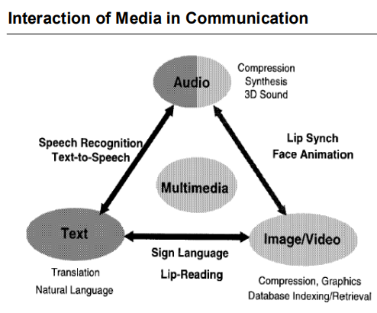

Slide 5
Categories of Multimedia
Multimedia may be broadly divided into linear and non-linear categories.
Linear Multimedia is a type of a multimedia that is designed to be presented in a sequential manner. It has a distinct beginning and end. It goes on a logical flow from a starting point to a conclusion.
It is usually intended for display purposes with not much interaction or distraction from the audience. Because of its nature where audience participation is not expected, Linear Multimedia may also be referred to as “Passive Multimedia”, such as a cinema presentation.
Non-linear content offers user interactivity to control progress as used with a computer game or used in self-paced computer based training.
Non-linear content is also known as hypermedia content.

Slide 6
Features of Multimedia
Multimedia presentations may be viewed in
person on stage,
projected,
transmitted, or
played locally with a media player.
A broadcast may be a live or recorded multimedia presentation. Broadcasts and recordings can be either analog or digital electronic media technology. Digital online multimedia may be downloaded or streamed. Streaming multimedia may be live or on-demand.
Multimedia games and simulations may be used in:
a physical environment with special effects.
with multiple users in an online network or locally with an offline computer, game system, or simulator.

Slide 7
Analogue Representation Vs Digital Representation
Compression Compression technique can be easily applied to digitized data. Since the digitization of an audio and video that much higher bit rates and longer time durations are involved. In order to reduce the bit rate to a level which various the communication networks can support, so the compression is applied to text, audio, image and video by different types of compression algorithms.

Slide 8
History Of Multimedia
The video game “Pong” that developed in 1972 by Nolan Bushnell.
In 1976, another revolution was about to start as friends Steve Jobs and Steve Wozniak founded a startup company called Apple Computer. A year later they unveiled the Apple II, the first computer to use color graphics.

Slide 9
History Of Multimedia
1981 saw IBM's first PC.
1984 Apple released the Macintosh, the first computer system to use a graphical user interface (GUI).
The Macintosh also bore the first mouse, which would forever change the way people interact with computers.

Slide 10
History Of Multimedia
In 1985, Microsoft released the first version of its Windows operating system.
In the same year, Commodore released the Amiga, a machine which many experts consider to be the first multimedia computer due to its advanced graphics processing power and innovative user interface.

Slide 11
History Of Multimedia
The Amiga did not fare well over the years, though, and Windows has become the standard for desktop computing.
Both Windows and the Macintosh operating systems paved the way for the lightning-fast developments in multimedia that were to come.

Slide 12
History Of Multimedia
In 1988, Macromedia (formerly called Macromind) released its landmark Director program, which allowed everyday computer users to create stunning, interactive multimedia presentations.
Today, Macromedia Flash drives most of the animation and multimedia you see on the Internet

Slide 13
Applications of Multimedia
Multimedia finds its application in various areas including, but not limited to,
advertisements
art
education
entertainment
engineering
medicine
mathematics
business
scientific research
temporal applications

Slide 14
Applications of Multimedia
Creative industries use multimedia for a variety of purposes ranging from fine arts, to entertainment, to commercial art, to journalism, to media and software services provided for any of the industries.
Commercial: Exciting presentations are used to grab and keep attention in advertising.
creative services firms for advanced multimedia presentations beyond simple slide shows to sell ideas or liven-up training.

Slide 15
Applications of Multimedia
Entertainment and Fine Arts
multimedia is heavily used in the entertainment industry, especially to develop special effects in movies and animations.
Multimedia games are a popular pastime and are software programs available either as CD-ROMs or online.

Slide 16
Applications of Multimedia
Education
multimedia is used to produce computer-based training
courses (popularly called CBTs)
A CBT lets the user go through a series of presentations, text about a particular topic, and associated illustrations in various information formats.

Slide 17
Applications of Multimedia
Engineering
Software engineers may use multimedia in Computer Simulations for anything from entertainment to training such as military or industrial training.
Medicine
doctors can get trained by looking at a virtual surgery or they can simulate how the human body is affected by diseases spread by viruses and bacteria.

Slide 18
Applications of Multimedia
Multimedia in Public Places
In hotels, railway stations, shopping malls, museums.
multimedia will become available at stand-alone terminals to provide information and help.

Slide 19
Stages of Multimedia Application Development
A Multimedia application is developed in stages as all other software are being developed.
In multimedia application development a few stages have to complete before other stages being, and some stages may be skipped or combined with other stages.
Following are the four basic stages of multimedia project development:

Slide 20
Stages of Multimedia Application Development
1- Planning and Costing : This stage of multimedia application is the first stage which begins with an idea or need. Before starting to develop the multimedia project, it is necessary to plan what writing skills, graphic art, music, video and other multimedia expertise will be required.
2- Designing and Producing : The next stage is to execute each of the planned tasks and create a finished product.

Slide 21
Stages of Multimedia Application Development
3- Testing : Testing a project ensure the product to be free from bugs. Apart from bug elimination another aspect of testing is to ensure that the multimedia application meets the objectives of the project.
4- Delivering : The final stage of the multimedia application development is to pack the project and deliver the completed project to the end user. This stage has several steps such as implementation, maintenance, shipping and marketing the product.

