Slide 1
Multimedia System
Assist. Lecturer
Safeen H. Rasool
Collage of Science
Department of IT

Slide 2
Multimedia Building Blocks
Any multimedia application consists any or all of the following components:
1- Text: Text and symbols are very important for communication in any medium. With the recent explosion of the Internet and World Wide Web, text has become more important than ever.
Web is HTML (Hyper text Markup language) originally designed to display simple text documents on computer screens, with occasional graphic images thrown in as illustrations.

Slide 3
Multimedia Building Blocks
2- Audio: Sound is perhaps the most element of multimedia. It can provide the listening pleasure of music or the ambience of a mood-setting background.
3- Images: play a vital role in a multimedia. It is expressed in the form of still picture, painting or a photograph taken through a digital camera.

Slide 4
Multimedia Building Blocks
4- Animation: Animation is the rapid display of a sequence of images of 2-D artwork in order to create an illusion of movement.

Slide 5
Multimedia Building Blocks
5- Video: Digital video has supplanted analog video as the method of choice for making video for multimedia use.

Slide 6
Text in Multimedia
Words and symbols in any form, spoken or written, are the most common means of communication.
Texts in the form of words, sentences and paragraphs is used to communicate thoughts, ideas and facts in nearly every aspect of our lives.
Text is a vital element of multimedia menus, navigation systems, and content.

Slide 7
Text in Multimedia
Proper use of text and words in multimedia presentation will help the content developer to communicate the idea and message to the user, even a menu text is accompanied by a single action such as mouse click, keystroke or finger pressed in the monitor (in case of a touch screen).

Slide 8
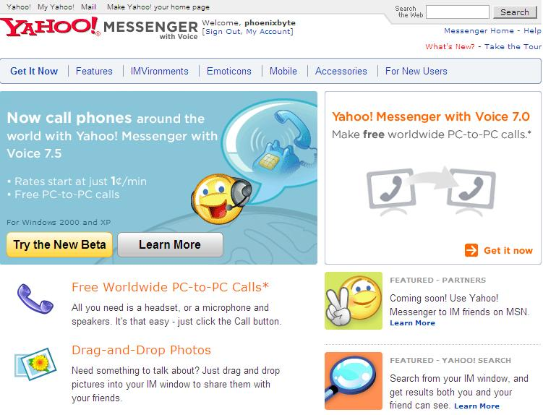
Text in Multimedia
Multimedia products depends on text for many things:
to explain how the application work.
to guide the user in navigating through the application.
deliver the information for which the application was designed.

Slide 9
What is Text?
Based on creating letters, numbers and special characters.
Text elements can be categories into:
Alphabet characters : A – Z
Numbers : 0 – 9
Special characters : Punctuation [. , ; ‘ …] , Sign or Symbols [* & ^ % $ £ ! /\ ~ # @ .…]
Also known Character Sets
May also include special icon or drawing symbols, mathematical symbols, Greek Letter etc.

Slide 10
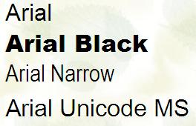
Fonts and Faces
A ‘typeface’ is a family of graphic characters that usually includes many type sizes and styles.
A typeface contains a series of fonts. For instance, Arial, Arial Black Arial Narrow and Arial Unicode MS are actually 4 fonts under the same family.

Slide 11
Fonts and Faces
A ‘font’ is a collection of characters of a particular size and style belonging to a particular typeface family.
Usually vary by type sizes and styles.
This includes the letter set, the number set, and all of the special character and diacritical marks you get by pressing the shift, option, or command/control keys.

Slide 12
Fonts and Faces
The size of a text is usually measured in points. One point is approximately 1/72 of an inch i.e. 0.0138.
The size of a font does not exactly describe the height or width of its characters. This is because the x-height (the height of lower case character x) of two fonts may differ.

Slide 13
The study of fonts and typefaces includes the following:
Font styles - boldface, italic, underline, outline
Font sizes - point, kerning, leading
Cases – uppercase, lowercase, intercap
Serif versus Sans Serif

Slide 14
Font Styles
The technology of font effects in bringing viewer’s attention to content:
Case: UPPER and lower cased letter
Bold, Italic, Underline, ^{superscript} or _{subscript}
Embossed or Shadow
Colours
b
Strikethrough

Slide 15
Font Sizes
Kerning is the spacing between character pairs
Leading is the space between lines.
A
v
Reading Line One
Reading Line Two
Leading

Slide 16
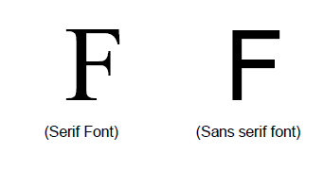
Examples of San Serif fonts
Century Gothic
Arial
Comic Sans MS
Impact
Tahoma

Slide 17
Font Editing and Design tools
In some multimedia projects it may be required to create special characters. Using the font editing tools
it is possible to create a special symbols and use it in the entire text.
Macromedia Fontographer. It is compatible with both Macintosh and Windows platform.
It can be used to develop PostScript, TrueType, and bitmapped fonts.
It can also modify existing typefaces and incorporate PostScript artwork.

