Slide 1
Multimedia System Image
Assist. Lecturer
Safeen H. Rasool
Collage of SCIENCE
Information technology Dept.

Slide 2
Image
Images are the important element of a multimedia project. In order to make a multimedia presentation look elegant and complete, it is necessary to spend amount of time to design the graphics and the layouts.
Competent, computer literate skills in graphic art and design are vital to the success of a multimedia project.

Slide 3
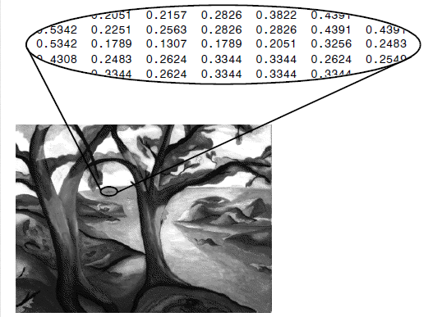
Digital Image
A digital image is represented by a matrix of numeric values each representing a quantized intensity value.

Slide 4
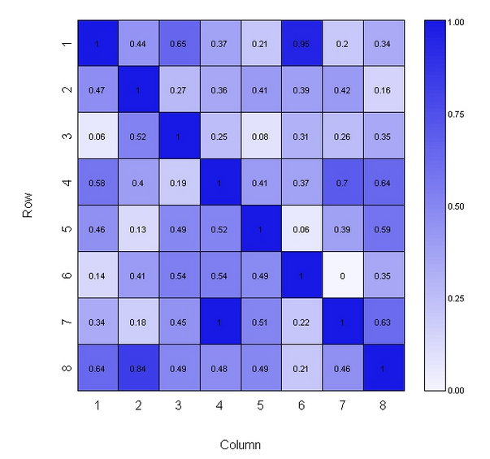
When I is a two-dimensional matrix, then I(r,c) is the intensity value at the position corresponding to row r and column c.

Slide 5
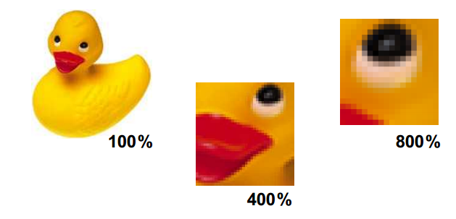
The points at which an image is sampled are known as picture elements, commonly abbreviated as pixels.
The intensity at each pixel is represented by an integer.

Slide 6
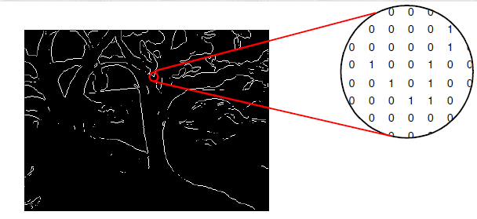
Digital Image
If there are just two intensity values, for example, black, and white, they are represented by the numbers 0 and 1; such images are called Binary Images.

Slide 7
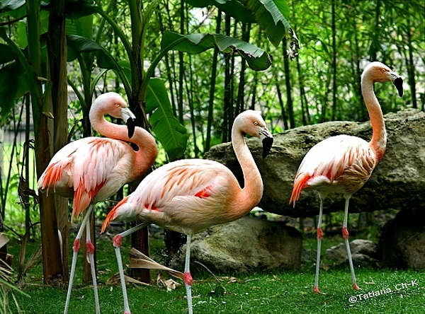
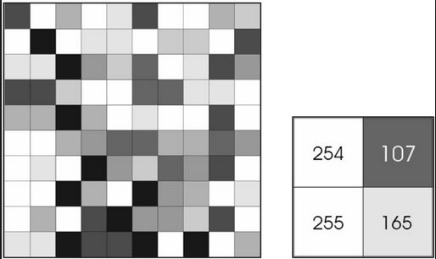
Digital Image
If 8-bit integers are used to store each pixel value, the gray levels range from 0 (black) to 255 (white).

Slide 8
Digital Image
The color white is a noisy mixture of all the color frequencies in the visible spectrum.

Slide 9
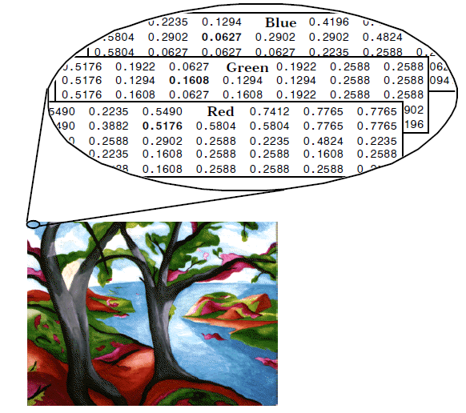
Digital Image
The eye can differentiate among millions of colors, consisting of combination of red, green, and blue(or Cyan Magenta Yellow and Black)CMYK.

Slide 10
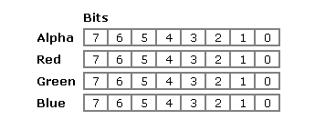
Color
A color is created as a combination of four 8-bit values. The first value is referred to as alpha but it is mostly used internally. The second is called red. The third is called green. The fourth is called blue:

Slide 11
Color
Therefore, each number can have a value that ranges from 0 to 255 in the decimal system. The alpha section is reserved for the operating system. The other three numbers are combined to produce a single value as follows:
Converted to decimal, this number has a value of 255 * 255 * 255 = 16581375. This means that we can have approximately 16 million colors available.

Slide 12
Color Depth
The combination of the display modes supported by your graphics adapter and the color capability of your monitor determine how many colors it displays. For example, a display that operates in SuperVGA (SVGA) mode can display up to 16,777,216 (usually rounded to 16.8 million) colors because it can process a 24-bit-long description of a pixel. The number of bits used to describe a pixel is known as its bit depth.

Slide 13
Color Depth
Bit-Depth 1
Colors: 2 (monochrome)
Bit-Depth 2
Colors: 4 (CGA)
Bit-Depth 4
Colors: 16 (EGA)
Bit-Depth 8
Colors: 256 (VGA)
Bit-Depth 16
Colors: 65,536 (High Color, XGA)

Slide 14
Color Depth
Bit-Depth 24
Colors: 16,777,216 (True Color, SVGA)
Bit-Depth 32
Colors: 16,777,216 (True Color + Alpha Channel)
Notice that the last entry is for 32 bits. This is a special graphics mode used by digital video, animation and video games to achieve certain effects.

Slide 15
Captured Image Format
The image format is specified by two main parameters:
spatial resolution, which is specified as pixels x pixels (e.g. 640 x 480)
color encoding, which is specified by bits per pixel. Both parameter values depend on hardware and software for input/output of images.

Slide 16
Resolution Depth
The resolution of an image tells you how small and densely packed the pixels are.
It tells you how many pixels you have per inch.
The higher resolution means sharper images look.
Monitors only have about 72 screen pixels per inch so any resolution above 72 won’t look any sharper on a computer screen (for printing 300 is best).
Most web graphics have a resolution of 72 pixels per inch.

Slide 17
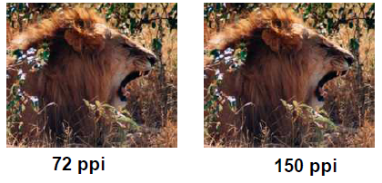
Resolution Depth

Slide 18
Making Still Images
Images are generated by the computer in two ways:
as bitmap (or paint graphics) are used for photo-realistic images. Pixel-based graphics are commonly known as bitmap graphics or raster images.
as vector-drawn (or just plain drawn) graphics. are used for lines, boxes, circles, polygons, and other graphic shapes that can be mathematically expressed in angles, coordinates, and distances.

Slide 19
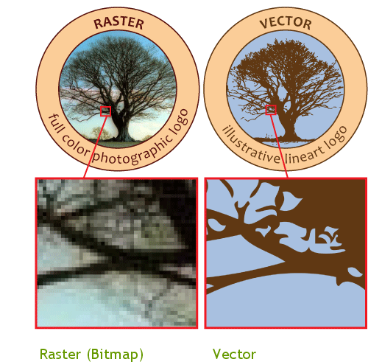
Many Flash animations also use vector graphics, since they scale better and typically take up less space than bitmap images.
File extensions: .AI, .EPS, .SVG, .DRW

Slide 20
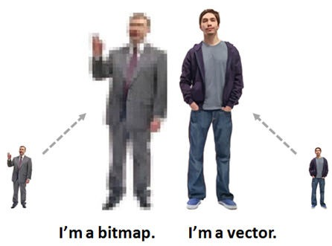

Slide 21
Image File Formats
JPEG (Joint Photographic Experts Group) is a lossy compression method;
TIFF (Tagged Image File Format) format is a flexible format that normally saves 8 bits or 16 bits per color (red, green, blue) for 24-bit and 48-bit totals,
RAW refers to raw image formats that are available on some digital cameras, rather than to a specific format. These formats usually use a lossless or nearly lossless compression, and produce file sizes smaller than the TIFF formats.

Slide 22
Image File Formats
GIF (Graphics Interchange Format) is limited to an 8-bit palette, or 256 colors. This makes the GIF format suitable for storing graphics with relatively few colors such as simple diagrams, shapes, logos and cartoon style images.
WEBP is a new open image format that uses both lossless and lossy compression. It was designed by Google to reduce image file size to speed up web page loading:

