Slide 1
Multimedia System
Assist. Lecturer
Safeen H. Rasool
Collage of SCIENCE
IT Dept.

Slide 2
Sound
Sound is perhaps the most important element of multimedia. It is meaningful “speech” in any language, from a whisper to a scream.
It can provide the listening pleasure of music,
Sound is the terminology used in the analog form, and the digitized form of sound is called as audio.

Slide 3
Sound
the perception of sound by human beings is a very complex process. It involves three systems:
- the source which emits sound.
- the medium through which the sound Propagates.
- the detector which receives and interprets the sound.
When something vibrates in the air is moving back and forth it creates wave of pressure.
the change of pressure or vibration is experienced as sound.
Sound pressure levels are measured in decibels (db)

Slide 4
Digital Audio
Digital audio is created when a sound wave is converted into numbers a process referred to as digitizing.
You can digitize sounds from a natural source or prerecorded.
Digitized sound is sampled sound. Ever n^{th} fraction of a second, a sample of sound is taken and stored as digital information in bits and bytes.
The quality of this digital recording depends upon how often the samples are taken.

Slide 6
Preparing Digital Audio Files
Creating a sound file need a good balancing between sound quality and your available RAM and Hard disk resources.
Audio resolution determines the accuracy with which a sound can be digitized.

Slide 7
Sampling rate
The sampling rate, or sampling frequency defines the number of samples per unit of time (usually seconds) taken from a continuous signal to make a discrete signal.
For time-domain signals, the unit for sampling rate is hertz (inverse seconds, 1/s, s⁻¹), sometimes noted as Sa/s or S/s (samples per second).

Slide 8
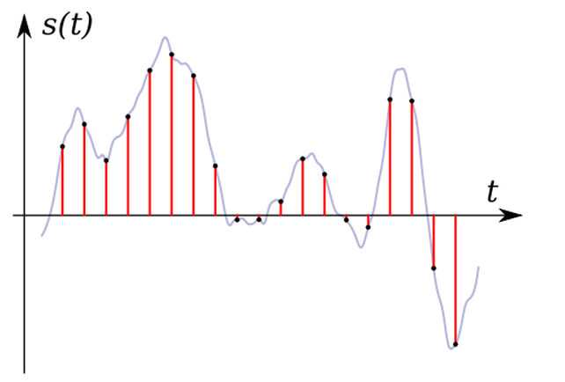
Sampling rate
Sampling rate determines the sound frequency range (corresponding to pitch) which can be represented in the digital waveform.
Pitch

Slide 9
The range of frequencies represented in a waveform is often called its bandwidth.
Waveforms sampled at a high sampling rate can represent a broad range of frequencies and hence have broad bandwidth.

Slide 10
Loudness and Amplitude
Two of important perceptual quality is loudness or volume.
Amplitude is the measure of sound levels. For a digital sound, amplitude is the sample value.
The reason that sounds have different loudness is that they carry different amount of power.
The unit of power is watt. The intensity of sound is the amount of power transmitted through an area of 1m² oriented perpendicular to the propagation direction of the sound.

Slide 11
If the intensity of a sound is 1watt/m² , The ear may be damaged.
The threshold of feeling If the intensity is
10⁻¹²watt/m², we may just be able to hear it.
The relative intensity of two different sounds is measured using the unit Bel or more commonly deciBel (dB).
It is defined by relative intensity in
dB = 10 log(I₂/I₁)

Slide 12
160 dB Jet engine
130 dB Large orchestra at fortissimo
100 dB Car on highway
70 dB Voice conversation
50 dB Quiet residential areas
30 dB Very soft whisper
20 dB Sound studio

Slide 13
Dynamic and Bandwidth
Dynamic range means the change in sound levels.
For example, a large orchestra can reach 130dB at its climax and drop to as low as 30dB at its softest, giving a range of 100dB.

Slide 14
Computer Representation of Sound
In order to store a sound wave in a computer, samples of the wave are taken.
Each sample is represented by a number, (a ‘code’).
This process is known as digitisation.
This method of digitising sound is know as pulse code modulation (PCM).

Slide 15
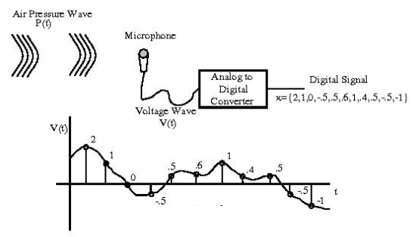

Slide 16
According to Nyquist sampling theorem, in order to capture all audible frequency components of a sound, i.e., up to 20kHz, one of the most popular sampling rate for high quality sound is 4410Hz.

Slide 17
Quality versus File Size
The size of a digital recording depends on the sampling rate, resolution and number of channels.
S = R x (b/8) x C x D
Higher sampling rate, higher resolution gives higher quality but bigger file size.
S file size bytes
R sampling rate samples per second
b resolution bits
C channels 1 - mono, 2 - stereo
D recording duration seconds

Slide 18
For example, if we record 10 seconds of stereo music at 44.1kHz, 16 bits, the size will be:
S = 44100 x (16/8) x 2 x 10
= 1,764,000bytes
= 1722.7Kbytes
= 1.68Mbytes
High quality sound files are very big, however, the file size can be reduced by compression.

Slide 19
Editing Digital Recordings
Once a recording has been made, it will almost certainly need to be edited. The basic sound editing operations that most multimedia procedures needed are:
1- Multiple Tasks: Able to edit and combine multiple tracks and then merge the tracks and export them in a final mix to a single audio file.
2. Trimming: Removing dead air or blank space from the front of a recording.
3. Splicing and Assembly: Using the same tools mentioned for trimming, you will probably want to remove the noises.

Slide 20
Editing Digital Recordings
4. Volume Adjustments: If you are trying to assemble ten different recordings into a single track there is a little chance that all the segments have the same volume.
5. Format Conversion: In some cases your digital audio editing software might read a format different from that read by your presentation.
6. Resampling or downsampling: If you have recorded and edited your sounds at 16 bit sampling rates but are using lower rates you must resample or downsample the file.

Slide 21
7- Equalization: Some programs offer digital equalization capabilities that allow you to modify a recording frequency content so that it sounds brighter or darker.
8-Reversing Sounds: Another simple manipulation is to reverse all or a portion of a digital audio recording.

Slide 22
Audio File Formats
A file format determines the application that is to be used for opening a file. Following is the list of different file formats and the software that can be used for opening a specific file.
1. *.AIF, *.SDII in Macintosh Systems
2. *.SND for Macintosh Systems
3. *.WAV for Windows Systems
4. MIDI files – used by Macintosh and Windows
5. *.WMA –windows media player
6. *.MP3 – MP3 audio
7. *.RA – Real Player
8. *.VOC – VOC Sound
9. AIFF sound format for Macintosh sound files
10. *.OGG – Ogg Vorbis

