Slide 1
Multimedia System
Assist. Lecturer
Safeen H. Rasool
Faculty of SCIENCE
IT Dept.

Slide 2
Animation
Animation is the process of making the illusion of motion and the illusion of change by means of the rapid succession of sequential images that minimally differ from each other.
It can add great power to our multimedia projects.
Animation is created from drawn pictures unlike video which is created using a real time visuals.

Slide 3
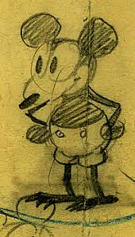
History of Animation
50 years ago Walt Disney create animation object like Mickey Mouse.

Slide 4
Animation
Persistence of Vision -biological phenomenon an object seen by the human eye remains mapped on the retina for a brief time after viewing.
Causes the visual illusion of movement, when images change slightly and rapidly

Slide 5
Principles of Animation
The word animation is from “Animate” which means to bring to life.
Television video creates 30 frames per second
Movies are shot at a rate of 24 frames per second and replayed at 48 frames per second
Both are used to create motion and animation

Slide 6
Animation Technique
Performance motion and motion capture
Traditional animation (frame by frame)
Path animation or Key frame
Rotoscoping

Slide 7
Motion capture and Performance motion
Is the process of recording the movement of objects or people.
It refers to record an action of human actors, and using that information to animate digital character models in 2D or 3D.
When it includes face and fingers or captures subtle expressions, it is often referred to as performance capture.

Slide 8
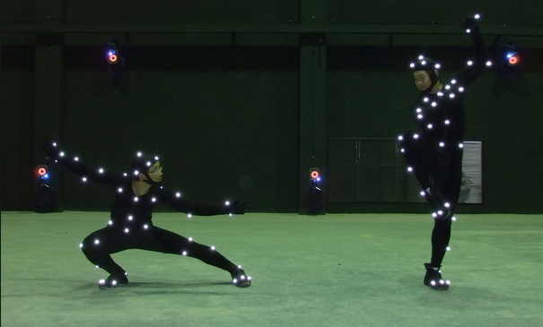
Motion capture and Performance motion

Slide 9
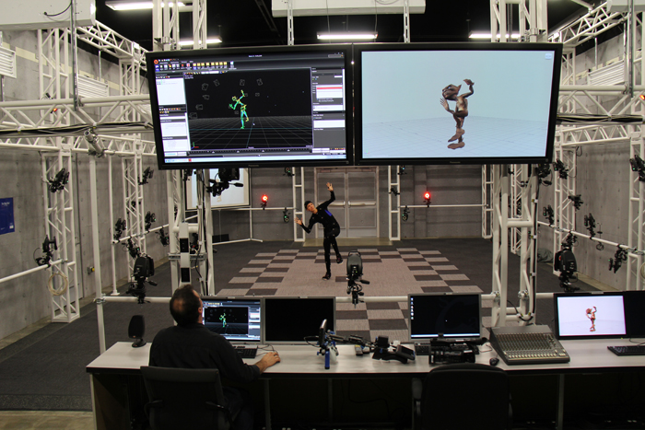

Slide 10
Advanced
Motion capture offers several advantages over traditional computer animation of a 3D model:
More rapid, even real time results can be obtained. In entertainment applications this can reduce the costs of keyframe-based animation.
The amount of work does not vary with the complexity or length of the performance to the same degree as when using traditional techniques
Complex movement and realistic physical.
The amount of animation data that can be produced within a given time is extremely large when compared to traditional animation techniques.

Slide 11
Markers
Passive markers: Passive optical system use markers coated with a retro reflective material to reflect light that is generated near the cameras lens. The camera's threshold can be adjusted so only the bright reflective markers will be sampled, ignoring skin and fabric.
Active marker: Active optical systems triangulate positions by illuminating one LED at a time very quickly or multiple LEDs with software to identify them by their relative positions, Rather than reflecting light back that is generated externally, the markers themselves are powered to emit their own light.

Slide 12
Software used for motion capture
Prime 41, Prime 17W, Flex 13, Slim 13E, eSync, OptiHub …..etc.

Slide 13
Traditional Animation or Cel Animation
Traditional Animation, (or Classical Animation, Cel animation, or hand-drawn animation)
Is an animation technique where each frame is drawn by hand. The technique was the dominant form of animation in cinema until the advent of computer animation.

Slide 14
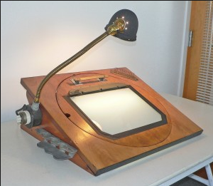
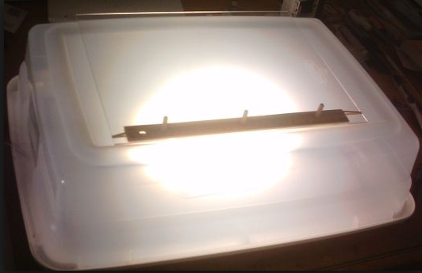
In the traditional animation process, animators will begin by drawing sequences of animation on sheets of paper perforated to fit the peg bars in their desks, often using colored pencils, one picture or "frame" at a time.
A peg bar is an animation tool that is used in traditional (cel) animation to keep the drawings in place.

Slide 15
Once in-between drawings for a sequence are completed, each drawing is then transferred from paper to a thin, clear sheet of plastic called a Cel.
Cel stands for Celluloid which is a clear sheet with images drown on them.
The Cel is usually animate in 24 frame per second, therefore a minute may require as many as 1440 separate frame.

Slide 16
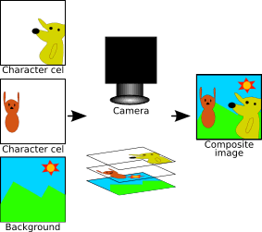

Slide 17
Computers and traditional animation
The drawings are composited in a computer program on many transparent "layers" much the same way as they are with cels, and made into a sequence of images which may then be transferred onto film or converted to a digital video format.
It is now possible for animators to draw directly into a computer using a graphics tablet, Cintiq or a similar device.

Slide 18
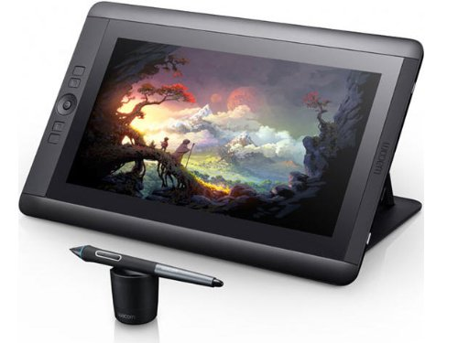
Cintiq

Slide 19
Path animation or Key frame
In this technique a storyboard is laid out and then the artists draw the major frames of the animation.
Animation is a drawing that defines the starting and ending points of any smooth transition.
Start with keyframes(the firest and last frame)

Slide 20
Path animation or Key frame
The series of frames in between the keyframes are drawn in a process called tweening.
Tweening required calculating the number of frames between keyframes and the path the actions take.
Because only two or three keyframes over the span of a second do not create the illusion of movement, the remaining frames are filled with in-betweens.

Slide 21
Filled By Tweening
Start Frame
End Frame

Slide 22
Rotoscoping animation
Rotoscoping is a technique where images are copied from a moving video into an animation. The animator draws the motion and shape of the object by referring to the video as opposed to imagining in his head.
With the help of the rotoscoping one can animate some complex scenes that would be hard to visualize otherwise.

Slide 23
Rotoscoping animation
The disadvantage is that one will have to hunt for the exact video that one wants to animate.

Slide 24
Software used for Animation creation
Some of the popular software packages used by the companies, schools and individuals all around the globe include:
3Dstudio Max.
LightWave3D: Light Wave 3D is another high end PC 3D computer software package
Adobe Premiere: Adobe Premiere is a tool that is used to composite Digitized video and apply a variety of transitions and special effects.
AliasIWavefront, Animator Studio, Elastic Reality, Soft Image, Strata Studio Pro, Director and Flash

